Slide 1

Problem Statement
(Business Opportunity)
Developers spend 30–40% of their time on repetitive reviews and boilerplate coding.
Knowledge gaps during onboarding due to missing documentation or inadequate handovers.
Unstructured logs slow incident resolution, delaying detection of errors, patterns, and root causes.

Slide 2

Market Gap
(Business Opportunity)
AI adoption in developer tools is accelerating, but solutions remain fragmented.
Code generation tools (e.g., Copilot) focus only on writing code → no reviews, no log intelligence.
Quality tools (e.g., SonarQube) enforce standards but lack AI-driven guidance or explanation.
Knowledge gaps during onboarding remain unsolved — no tool acts as a living code knowledge assistant.
Enterprises need a single integrated AI assistant across the entire SDLC.

Slide 3
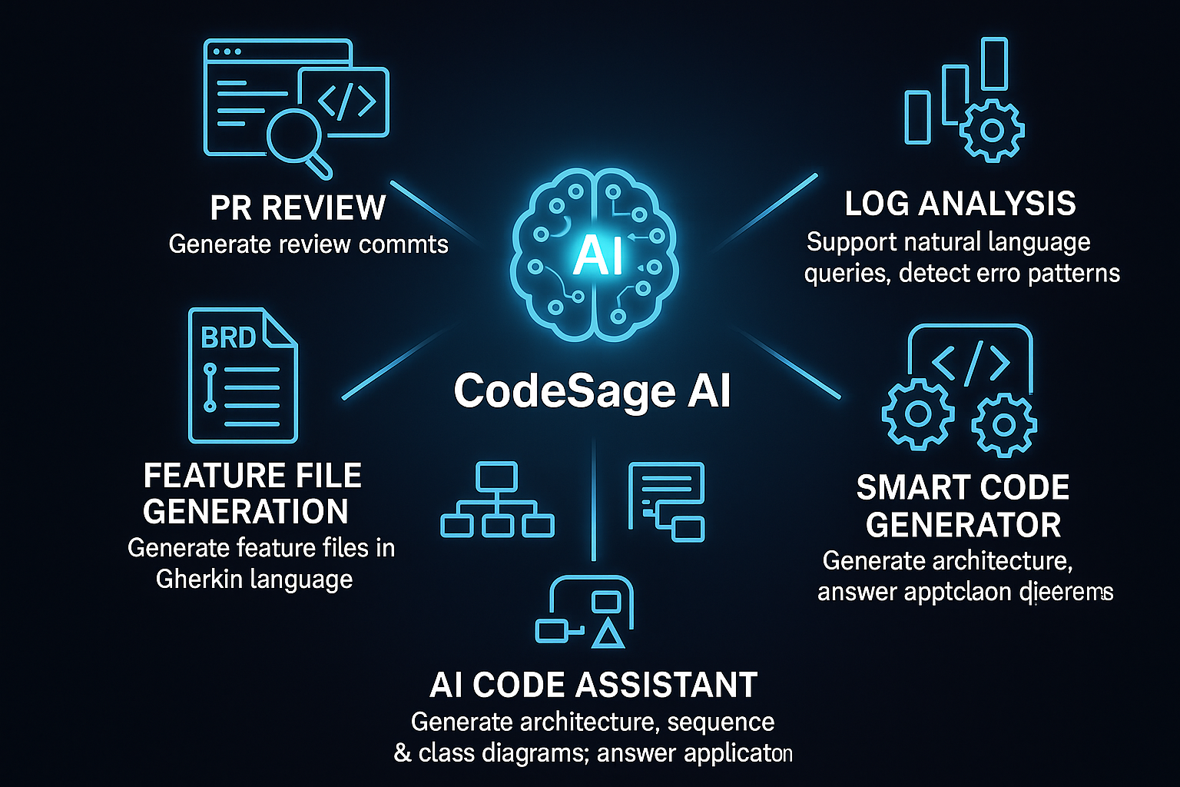
CodeSage AI – All-in-One Intelligent Coding Hub
(Solution Approach)
Unified AI Hub – Covers review, generation, analysis, and assistance.
Boosts Productivity – Reduces repetitive tasks, accelerates onboarding.
Smarter Decisions – AI-powered insights from logs, patterns, and diagrams.
Reusable & Scalable – Supports multiple frameworks and project sizes.
Competitive Edge – Combines fragmented capabilities into one intelligent assistant.
Accelerates Time-to-Market – Faster delivery with fewer defects.

Slide 4
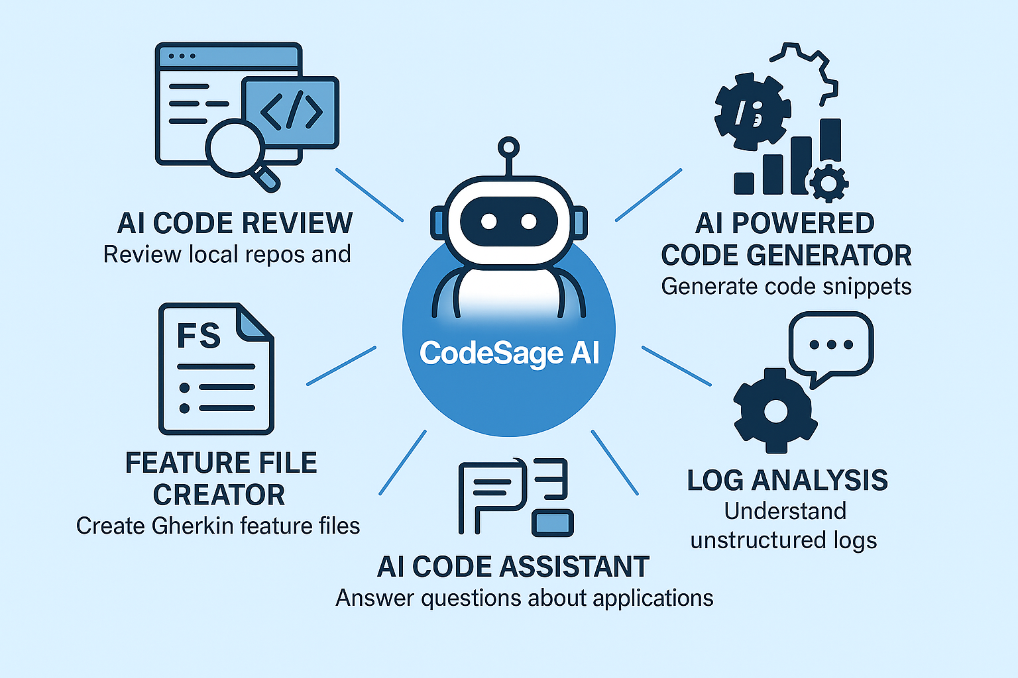
Feature Overview – CodeSage AI Capabilities
(Solution Approach with Benefits)
AI Code Review – Reviews local repos & PRs, suggests improvements, ensures coding standards.
AI Powered Code Generator – Generates project skeletons (Spring Boot, Angular, React), plus reusable code snippets.
Feature File Creator – Creates Cucumber feature files in Gherkin syntax for automated testing.
Log Analysis – Understands unstructured logs, supports natural language queries, detects anomalies.
AI Code Assistant – Answers queries about applications, generates architecture & sequence diagrams.

Slide 5

AI Code Review - Smarter, Faster, Standardized
(Solution Approach with Benefits)
Reviews Repositories & PRs – Analyzes local repos and GitHub/GitLab PRs.
Auto-Suggests Improvements – Provides contextual, actionable review comments.
Ensures Coding Standards – Detects violations of best practices & style guides.
Accelerates Delivery – Reduces manual review time by 30–40%.
Integrates Seamlessly – Works with CI/CD pipelines and developer tools.

Slide 6
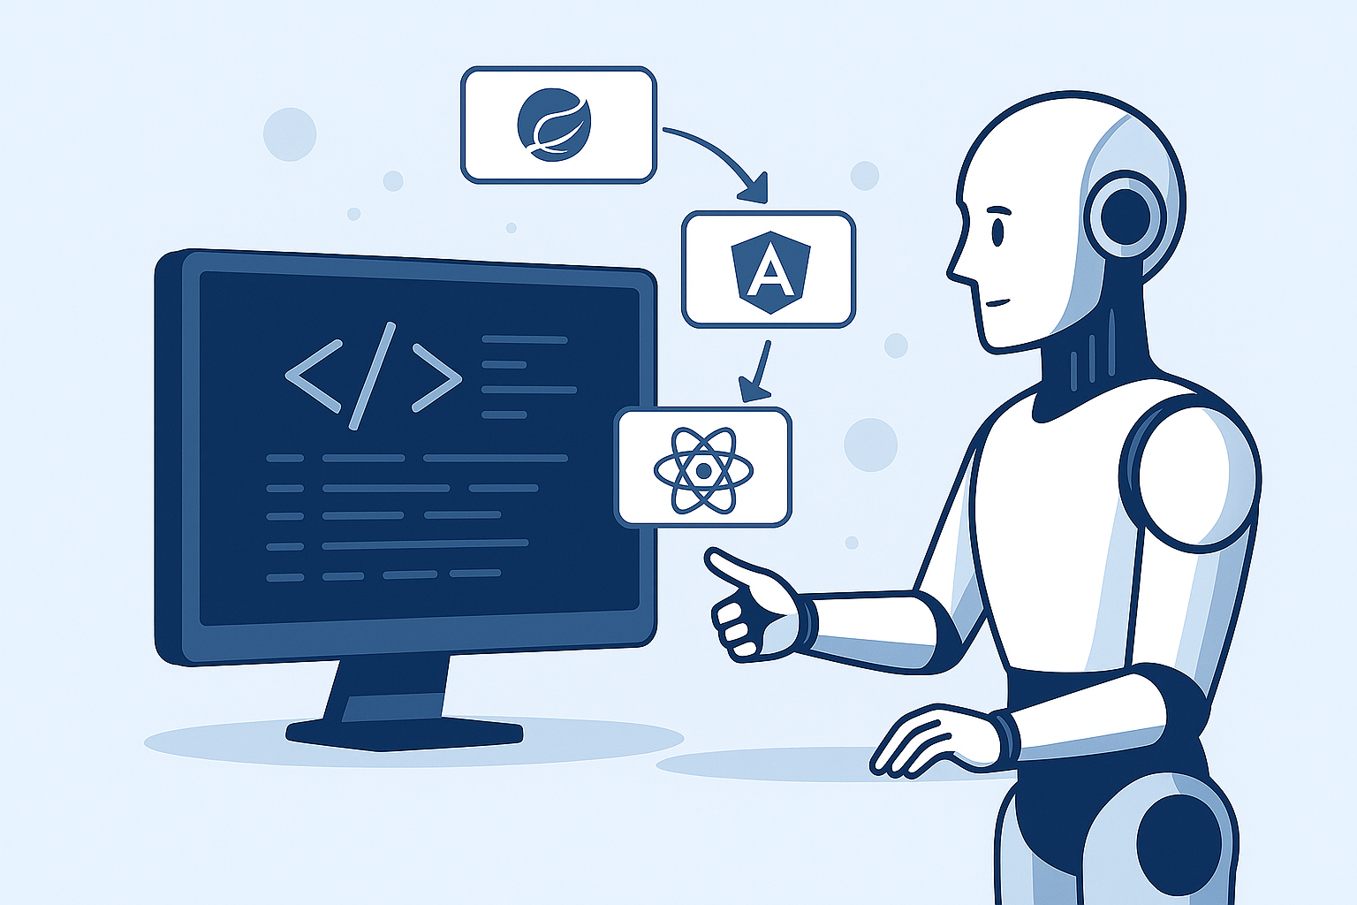
AI Powered Code Generator - Fast, Accurate, Adaptive
(Solution Approach with Benefits)
Generates Project Skeletons – Creates ready-to-use templates for Spring Boot, Angular, React, and microservices.
Reusable Code Snippets – Provides tested, modular snippets for common tasks (auth, logging, error handling, APIs).
Customization & Flexibility – Adapts generated code to project-specific frameworks, standards, and guidelines.
Boosts Developer Productivity – Eliminates boilerplate coding; developers focus on core business logic.
Accelerates Time-to-Market – Rapid prototyping and delivery with reduced errors.
Seamless Integration – Works with existing repositories, build tools, and CI/CD pipelines.

Slide 7
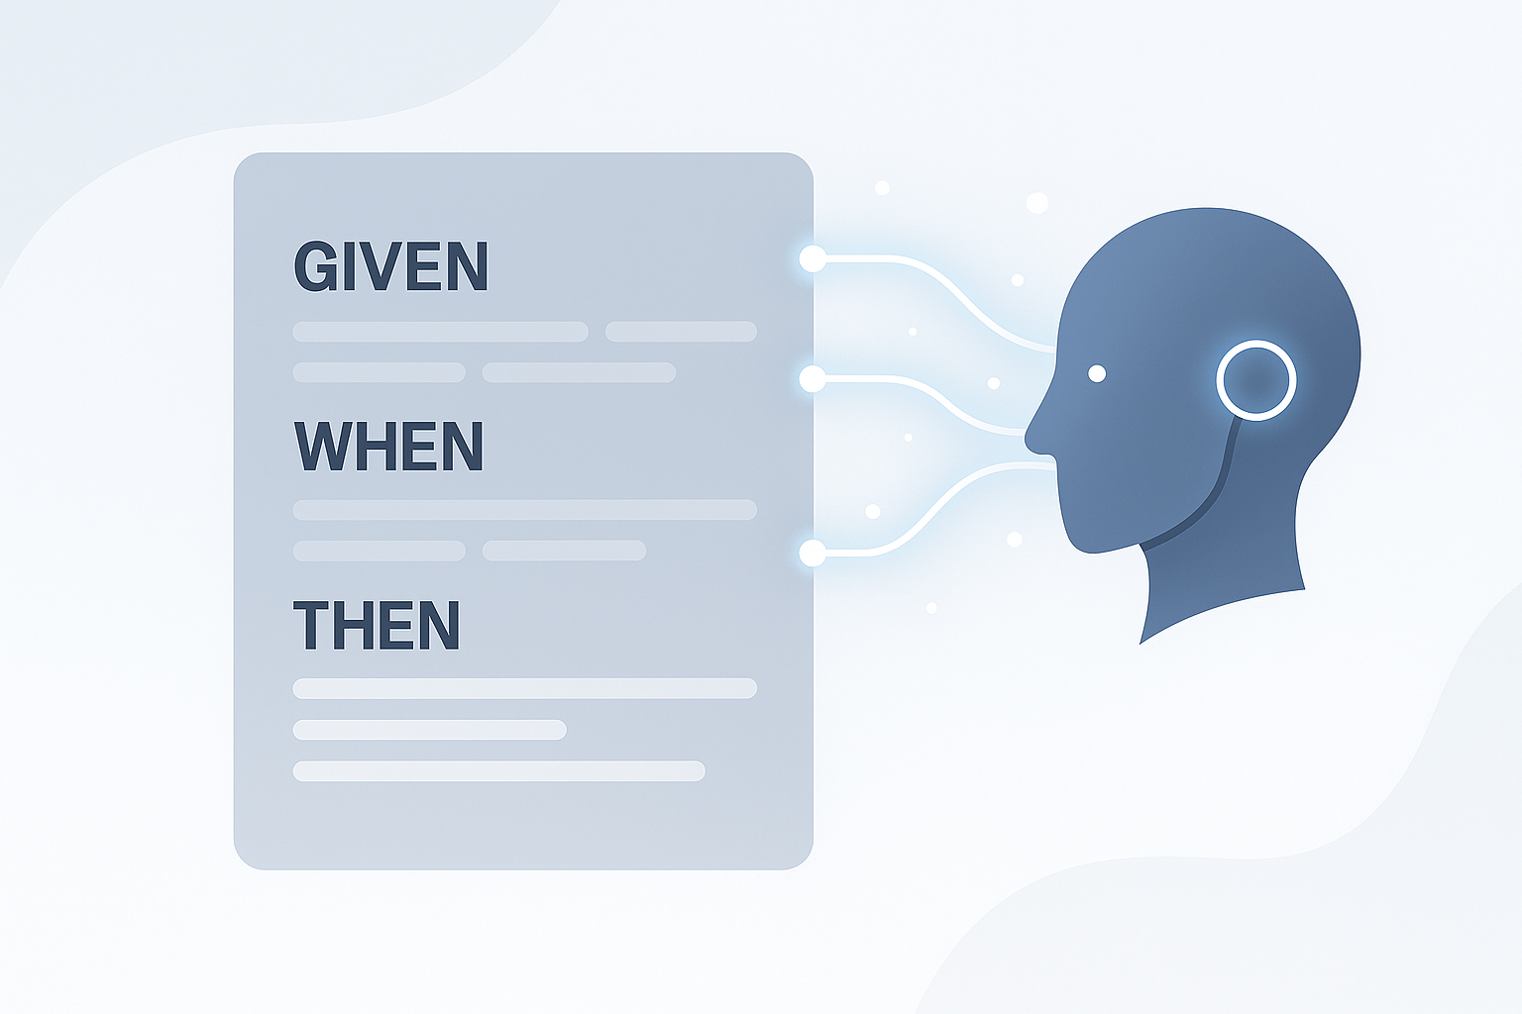
Feature File Creator – Simplified Test Automation
(Solution Approach with Benefits)
Generates Cucumber Feature Files – Auto-creates Given/When/Then scenarios from user stories or requirements.
Bridges Dev & QA – Ensures shared understanding between developers, testers, and business analysts.
Reduces Manual Effort – Eliminates repetitive writing of feature files.
Improves Test Coverage – Captures edge cases and requirements systematically.
Accelerates Automation – Ready-to-use feature files integrate seamlessly into Cucumber-based test frameworks.

Slide 8
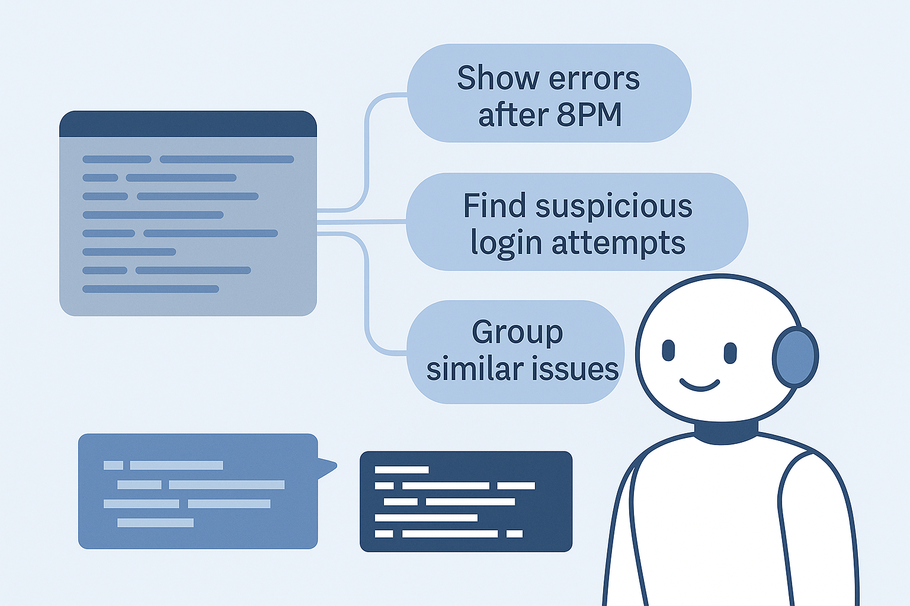
Log Analysis– Intelligent Insights from Unstructured Data
(Solution Approach with Benefits)
Understands Unstructured Logs – Processes large volumes of raw log data across distributed systems.
Natural Language Queries – Enables queries like “Show errors after 8PM” without needing technical filters.
Pattern Detection – Identifies anomalies such as suspicious login attempts or unusual transactions.
Error Categorization – Groups similar issues to speed up root-cause analysis.
Accelerates Incident Resolution – Reduces MTTR (Mean Time to Resolution) by providing actionable insights quickly

Slide 9
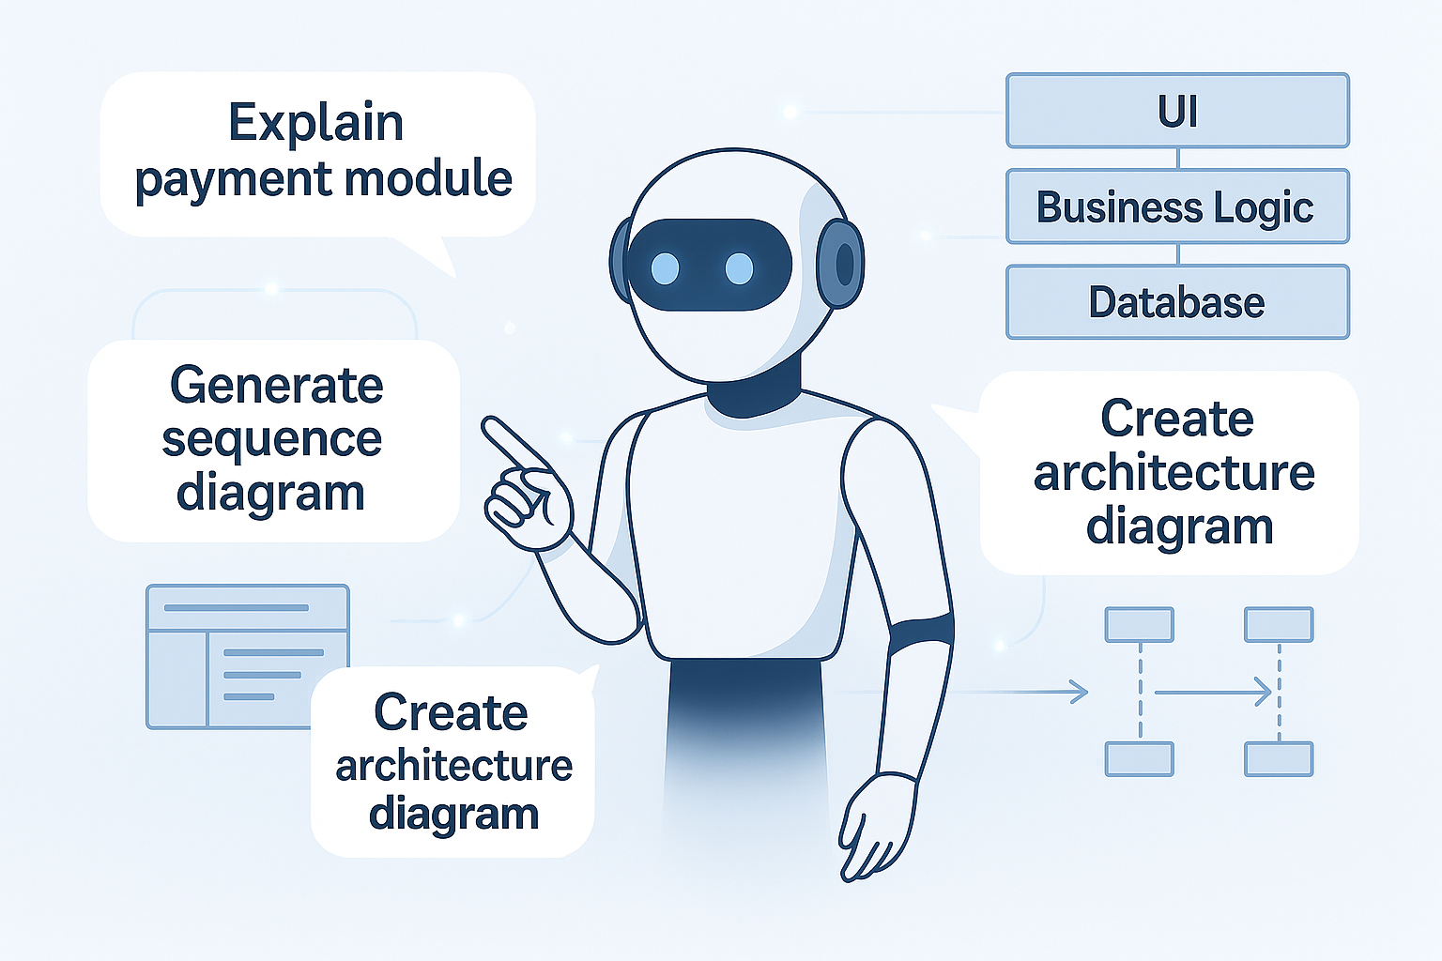
AI Code Assistant – Knowledge at Your Fingertips
(Solution Approach with Benefits)
Answers Application Queries – Provides instant explanations for modules, workflows, and processes (e.g., “Explain payment module”).
Generates Diagrams on Demand – Creates architecture, class, and sequence diagrams from source code.
Accelerates Onboarding – Reduces dependency on documentation and handovers for new developers.
Boosts Knowledge Retention – Maintains tribal knowledge by making it queryable anytime.
Enhances Collaboration – Offers a shared, interactive knowledge base across teams.
Increases Developer Productivity – Saves time otherwise spent searching, asking, or guessing.

Slide 10

Innovativeness
(Innovativeness)
First-of-its-kind unified AI tool combining review, generation, and assistance.
Moves beyond isolated plugins → delivers an integrated developer experience.
Supports both structured (code) and unstructured (logs, queries) inputs.
Bridges knowledge gaps → accelerates onboarding without manual handovers.
Continuously learns & adapts from developer usage patterns.

Slide 11

User Experience
(User Experience)
Simple, intuitive interface tailored for developers.
AI assistant responds in plain language for accessibility.
Interactive dashboards for logs, code, and diagrams.
Provides instant, contextual suggestions → reduces back-and-forth.
Seamless integration with GitHub, GitLab, Jenkins, and IDEs.

